Slide 1
Project presentation (week 2)
Submitted to :
Ashfaq Ali Shafin
Lecturer
Dept. of CSE
Stamford University,
Bangladesh
Submitted by:
Group:
( Creative Originality )
Tahmim Al Ashik CSE06307448
Sharmi Mondal CSE06307454
Md. Jafor Iqbal CSE06307452

Slide 2
Goals of this presentation
Gathering knowledge about proposed project
Determine some questions and enrich knowledge level with the answer of that questions .
Take some hints from currently existed system
Presenting Diagram of the survey result

Slide 3
Information Gathering Steps
Steps of gathering Information :
1.Interview of expert
2.Field survey on questions
Information
3.Hints from existed system

Slide 4

Interview Pattern
We have followed pyramid pattern questionnaires
4 short questions
4 details questions

Slide 5
Interview Person
MD. Mozammel Hossain
(email : mozammelhossain442@gmail.com)
AM , Kemiko Pharmaceuticals Ltd.
338, Segun Bagicha, Dhaka-1000, Bangladesh .

Slide 6
Interview Question and Answer
At present time how it looks the position of the pharmaceutical company from economical point of view ? Good or bad ?
Good
From your views ,How kemiko operate their activity ? With update technology or manual process ?
70% manual process
Which type of software they have already included with their system ?
Office management tools have added

Slide 7
Interview Question and Answer
How many pharmaceutical product have been producing by Kemiko pharma ?
245 product have been producing in local market
Have there any opportunity to do something for their advertisement ?
Obviously there have lot of opportunity . We have been producing lot of product in local market and this business is stand on the advertisement of the product . Every moment we need to fight with other companies so company will grab it if you give any latest idea of company advertisement

Slide 8
Interview Question and Answer
We want to make a app on the product list . Where product will present with generic name and other related popular product name will be presented . Is this idea work for advertisement ?
Good idea . Maximum pharmaceutical company have not any mobile app for local people .But you can add some other features .
For example ?
You can add a section for referred doctor info of that company . Doctor will also get some benefit from there and local people also get some info from there of specialized doctor . Then you can add a section for the drug house operator where they can call a local representative of the pharmaceutical company for the product.

Slide 9
Interview Question and Answer
What are the obstacles we may face ?
You need lot of data and at first you need to make sure all data are correct .Because single error of data make big disaster in the market of a pharmaceutical company and it is also related with their fame . So be careful about collecting data and make sure you have enough knowledge on full project

Slide 10
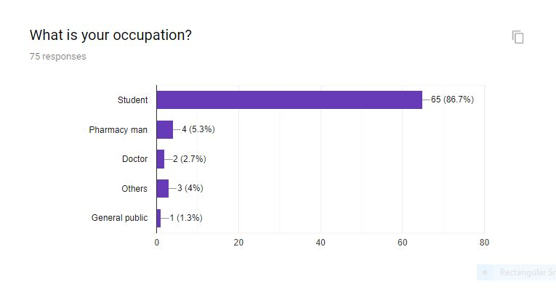
Field survey on Questions

Slide 11
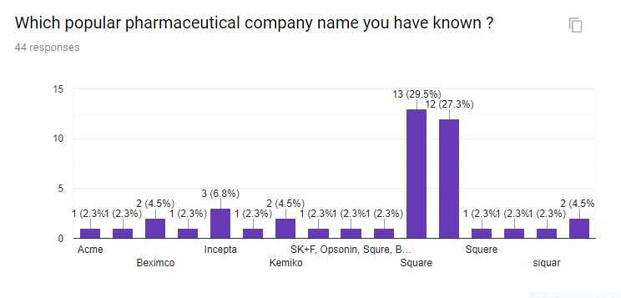
Field survey on Questions

Slide 12
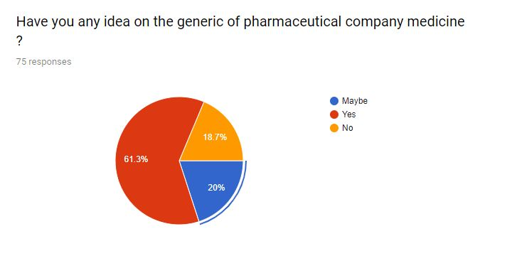
Field survey on Questions

Slide 13
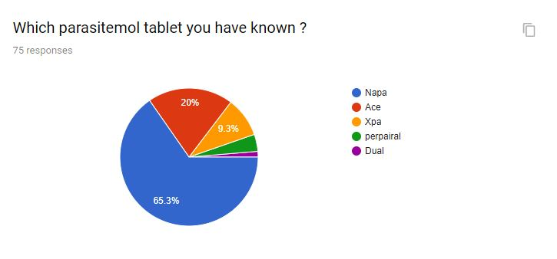
Field survey on Questions

Slide 14
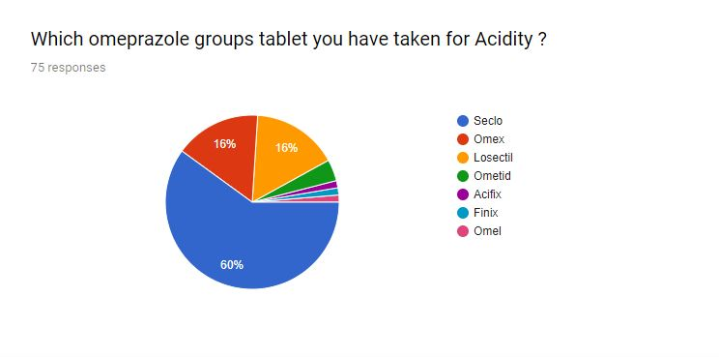
Field survey on Questions

Slide 15
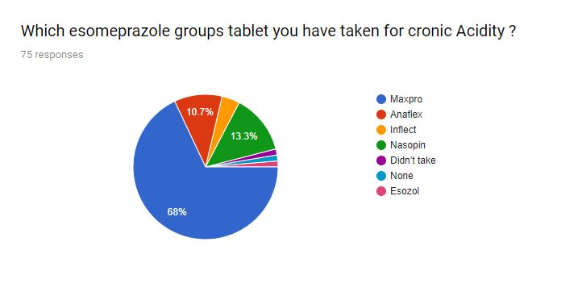
Field survey on Questions

Slide 16
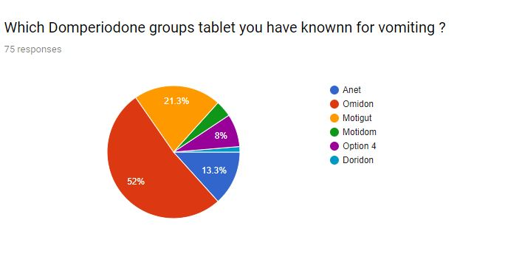
Field survey on Questions

Slide 17
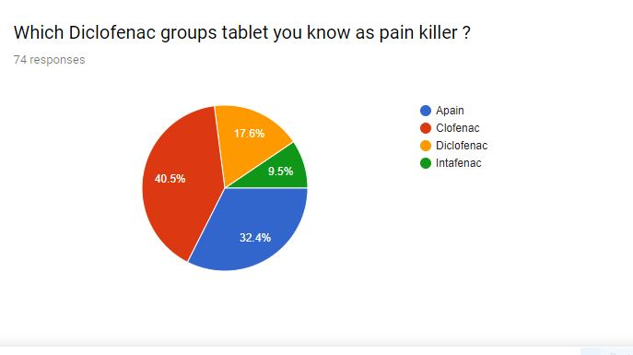
Field survey on Questions

Slide 18
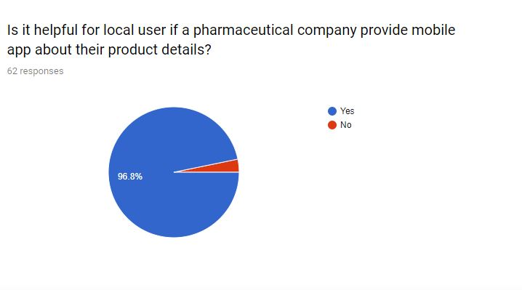
Field survey on Questions

Slide 19
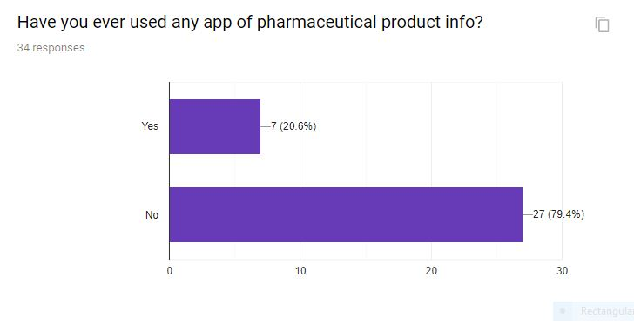
Field survey on Questions

Slide 20
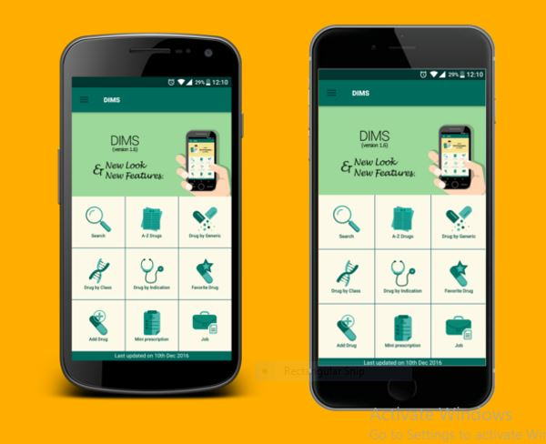
Hints from existent software
We have taken some hints form http://dimsbd.com/ .
Difference between dims and our software :
Dims have been working on whole product info of pharmaceutical company in Bangladesh . But we are working on a significant company and his product and referred doctor info. But Dims have no doctor info or several company info .

Slide 21
Thanks to all

